Slide 1


Slide 2


What is the J.M.B.A.O.C?
It is a service provided by the War For Truth Ministries’ Deliverance From Addiction Outreach
It is a faith-based addiction outreach center where addicts and those that love them can be educated, life coached and ministered to.

Slide 3
Our Goals
To educate addicts and those that love them concerning all aspects of addiction.
To push back against false narratives that keep people in bondage to addiction.
To reveal the spiritual aspect of addiction, which is the missing key element in most addiction treatment programs, especially secular-based ones, and is the key to true deliverance from addiction.
To help addicts overcome the addiction mindset.
To lead them to true deliverance through Jesus Christ.

Slide 4
About Our Ministry
War For Truth Ministries was founded in 2022 by Thomas W. Pohl.
In 2024, God revealed his calling in this season was to minister to drug addicts and those that love them.
The Deliverance From Addiction Outreach was birthed soon thereafter.

Slide 5
About Our Outreach
The “Deliverance From Addiction” YouTube channel was founded in August 2023.
The Deliverance From Addiction Outreach was founded in November 2024.
Thomas W. Pohl’s book “Deliverance From Addiction: Breaking the Yoke & Healing the Hurt” was published in December 2024.
The “Deliverance From Addiction” TikTok channel was founded in May 2025.
The Jessica Marie Baker Addiction Outreach Center project was conceptualized in June 2025. Opening TBD.

Slide 6
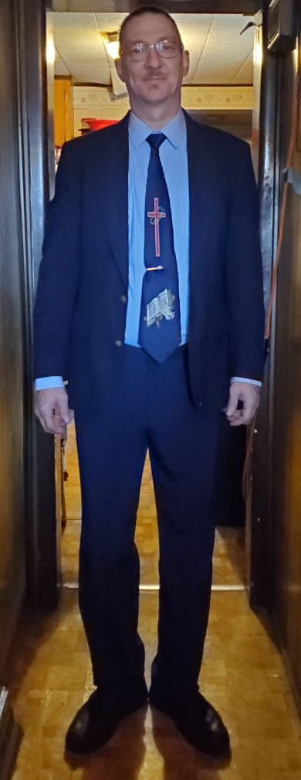
About Our Founder
Thomas W. Pohl is the founder of War For Truth Ministries and its Deliverance From Addiction Outreach.
He has been ministering to drug addicts since 2015.
He has personally led multiple individuals to lasting freedom from addiction and salvation in Jesus Christ.
He is the author of the book, “Deliverance From Addiction: Breaking the Yoke & Healing the Hurt” which was published in December 2024.
He started teaching a course entitled, “Understanding Addiction” at XIXI Now Success Academy Worldwide for their Spring 2026 semester.

Slide 7
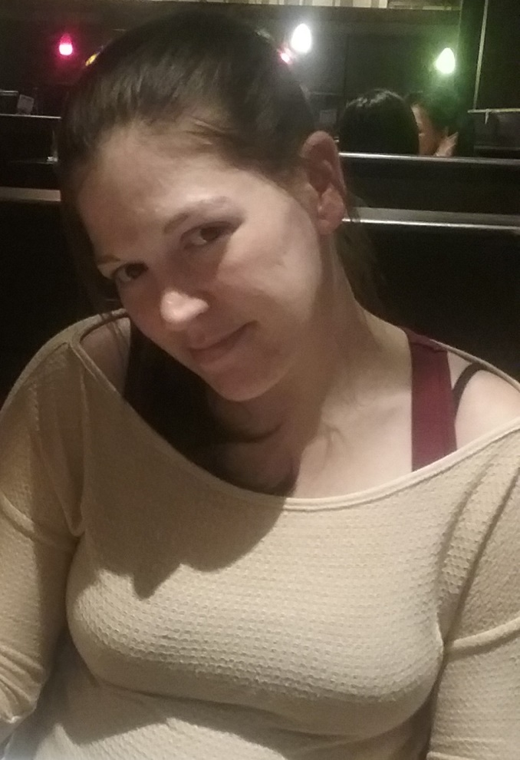
Who is Jessica Marie Baker?
She was a dear friend of Thomas W. Pohl who tragically died of a drug overdose in 2018 despite having given her life to Jesus Christ one month prior.
Her painful death led to an impassioned plea to God to not let her death be in vain and to turn it around for good. Four months later, God answered that plea and dropped his book on his heart.
Her death would ultimately birth the Deliverance From Addiction Outreach.
Thomas wanted to honor Jessica’s memory by naming his future addiction outreach center in her honor. In July 2025, her father Richard enthusiastically gave him his blessing to do so.

Slide 8

What Do Clients Receive?
All addicts and their loved ones will receive a Bible and a copy of Thomas W. Pohl’s book “Deliverance From Addiction: Breaking the Yoke & Healing the Hurt” free of charge.
Addiction Education
Life Coaching
Ministry

Slide 9
What Do Clients Receive?
Addiction Education
  Addicts and their loved ones will be educated concerning all aspects of addiction.
  False prevailing narratives will be exposed and pushed back against.
  Medicine Replacement Therapy fallacies will be exposed.
  The missing key element lacking in most addiction treatment programs will be revealed and how this key can lead to freedom from addiction once and for all.

Slide 10
What Do Clients Receive?
Life Coaching
  Addicts will receive life coaching in order to help transform their limiting beliefs and limited mindset to a growth mindset.
  To teach addicts that the addiction mindset and can be changed for the better.
  To teach addicts that there is a better alternative to the addiction lifestyle.

Slide 11
What Do Clients Receive?
Ministry
  Addicts and their loved ones will receive ministry in the areas that they are struggling in.
  Addicts will receive spiritual nourishment to help fill the voids in their life.
  Addicts will learn how the Word of God (i.e. Bible) can help them overcome the unresolved traumas in their life.
  The goal of Ministry is to lead the addict to true deliverance from addiction and salvation in Jesus Christ.

Slide 12
Links & Resources
  Deliverance From Addiction Outreach:
    https://www.deliverance-from-addiction-outreach.org/
  Deliverance From Addiction Book:
    https://www.deliverancefromaddictionbook.com/
  YouTube Channel:
    https://www.youtube.com/@DeliveranceFromAddiction
  TikTok Channel:
    https://www.tiktok.com/@deliverancefromaddiction
  Email:
    deliverancefromaddiction@gmail.com
  War For Truth Ministries:
    https://www.wftministries.org/

